Slide 1
200+ Financial indicators of us stocks in 2018
STA9890
Hui Zhu

Slide 2
Data description
This dataset collects 200+ financial indicators for all the stocks of the US stock market.
Shape of data: Observations = 4393; P = 40
The response variable: Price.Variation
The predictors variables: Financial indicators of US stocks (standardized)
Dataset link: https://www.kaggle.com/cnic92/200-financial-indicators-of-us-stocks-20142018/data?select=2018_Financial_Data.csv
Github link: https://github.com/zh2323/STA9890

Slide 3
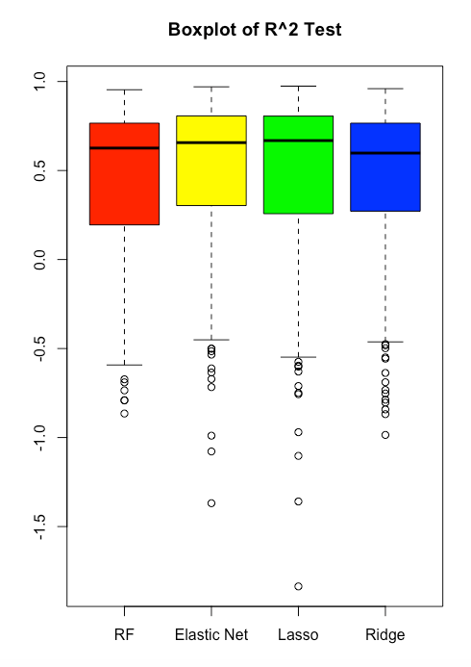
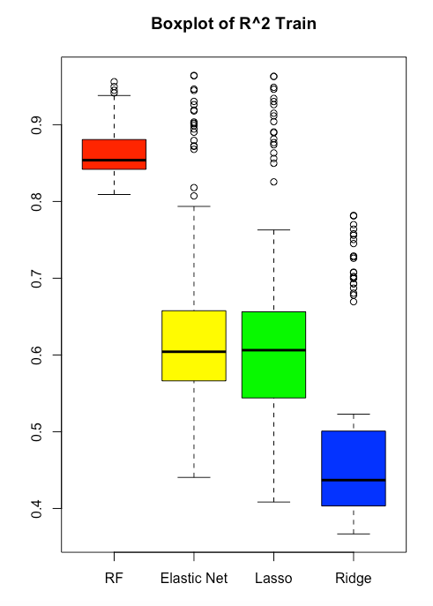
Side-by-side boxplot of R²_{test}, r²_{train}

Slide 4
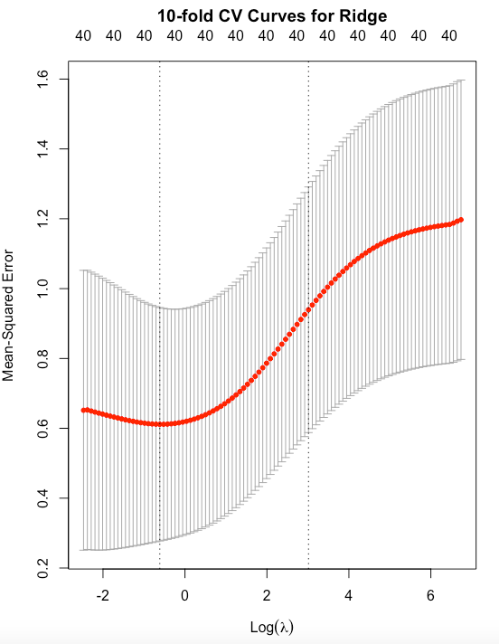
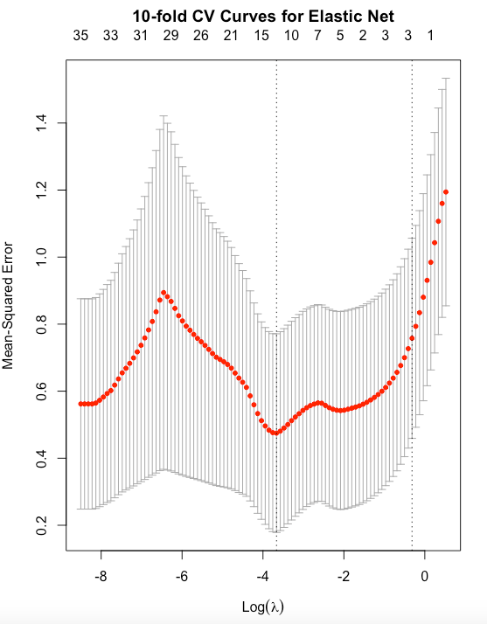
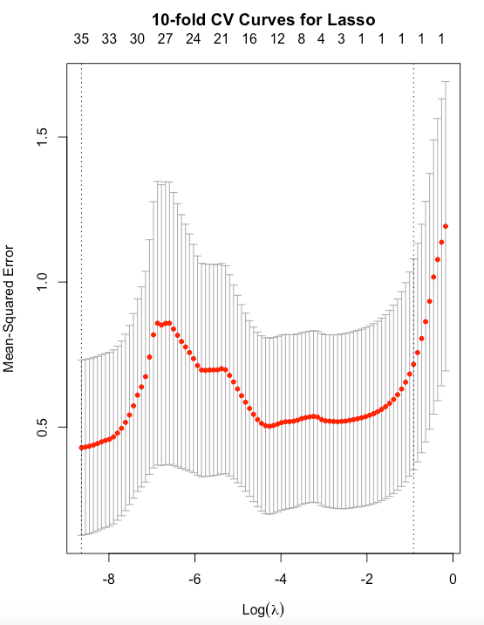
10-fold cv curves for lasso, elastic-net, ridge

Slide 5
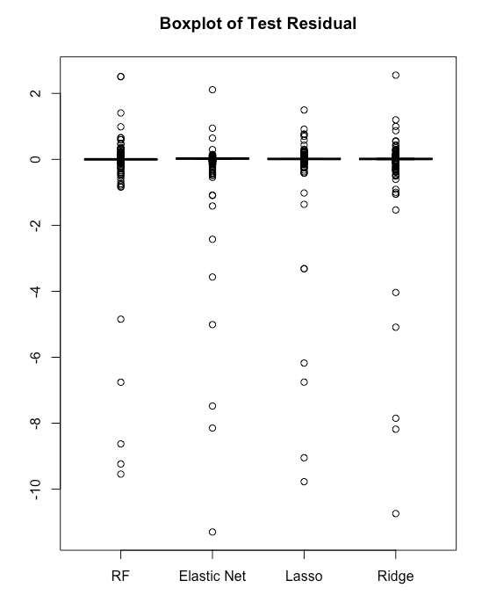
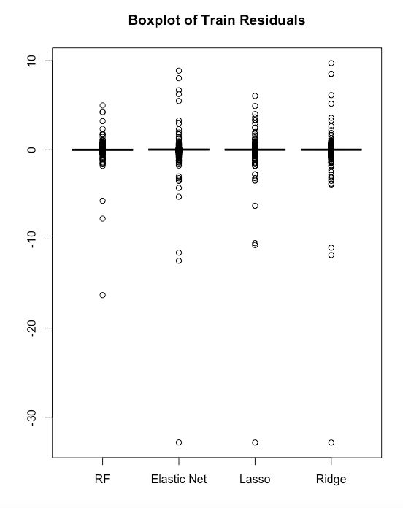
Boxplots of train and test residuals

Slide 6
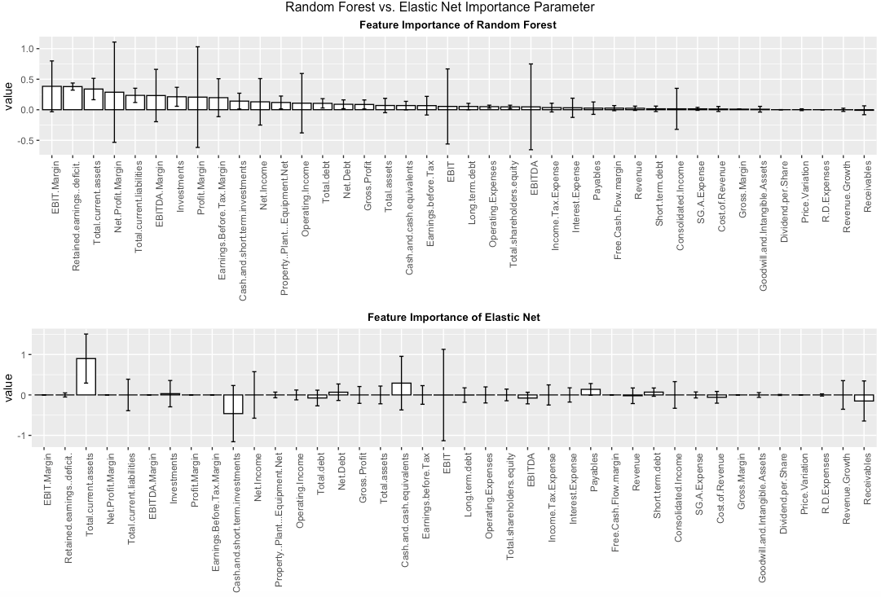
Bar-plots of the estimated coefficients and importance of parameters

Slide 7
Summary
Performance: The Elastic Net model performs similar to the Lasso
Time:
Model | Time for Training for 1 time | Time for Training for 100 times
Lasso | 0.391 sec | 0.67 min
Elastic Net | 0.415 sec | 0.42 min
Ridge | 0.381 sec | 0.38 min
Random Forest | 0.398 sec | 7.45 min

